Slide 1
Pixel 3 GMS App Investigations
Part 1: GMS Messaging
Notes:
https://digitalcorpora.s3.amazonaws.com/corpora/mobile/android_10/Non-Cellebrite%20Extraction/Pixel%203.zip

Slide 2
Background

Slide 3

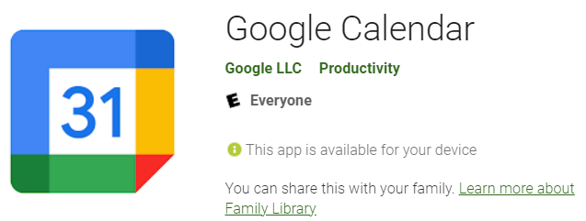
Google Mobile Services (GMS)
GMS is a collection of Google applications and APIs
Google proprietary/native application
GMS helps support functionality across devices.
These apps work together seamlessly to ensure your device provides a great user experience right out of the box.
GMS package pattern: com.google.android.calculator
Notes:
https://www.android.com/gms/

Slide 4

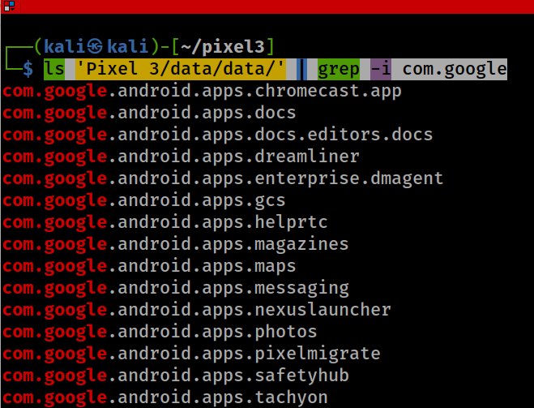
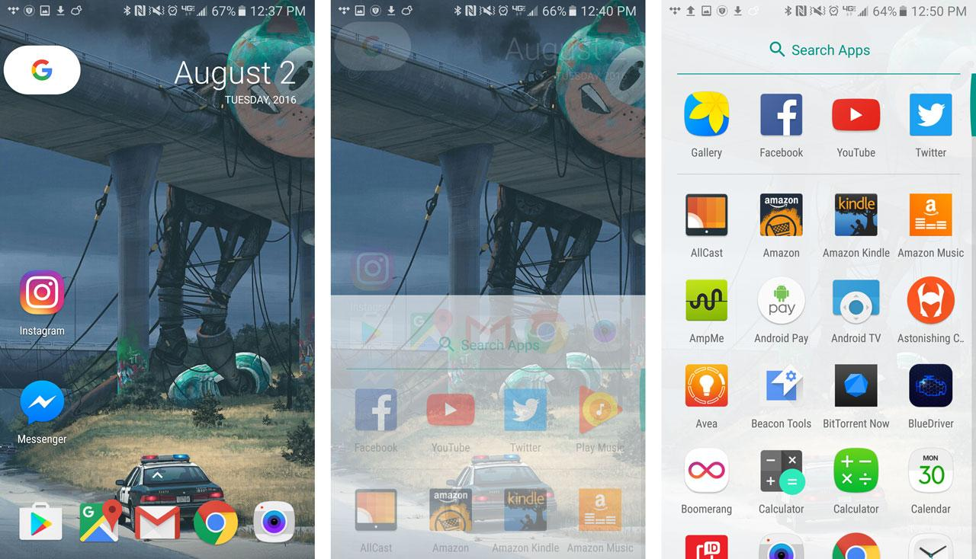
Show all Google GMS Apps: com.google.*
‘dreamliner’ wireless charging widget support
Notes:
ls 'Pixel 3/data/data/' | grep -i com.google

Slide 5



Investigating 3 GMS Apps
Investigating Google Messages
com.google.android.apps.messaging
Investigating Google Maps
com.google.android.apps.maps
Investigating Google Photos
com.google.android.apps.photos

Slide 6
Investigating Google Messages

Slide 7
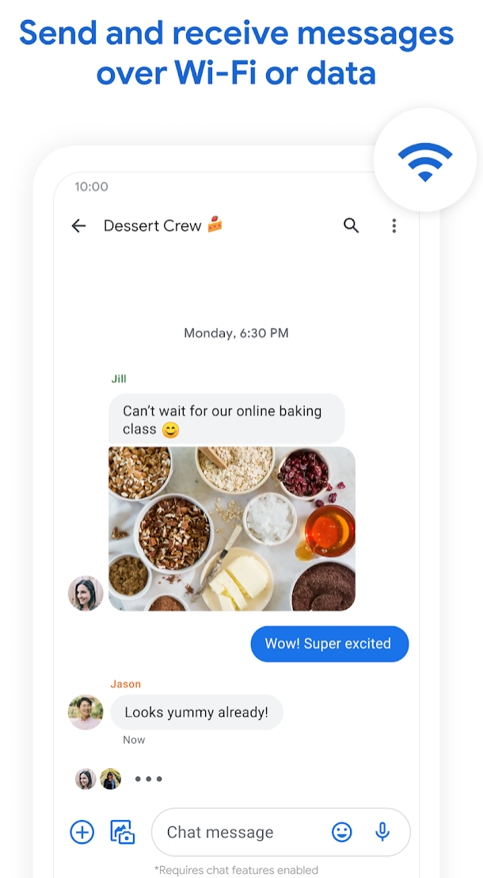
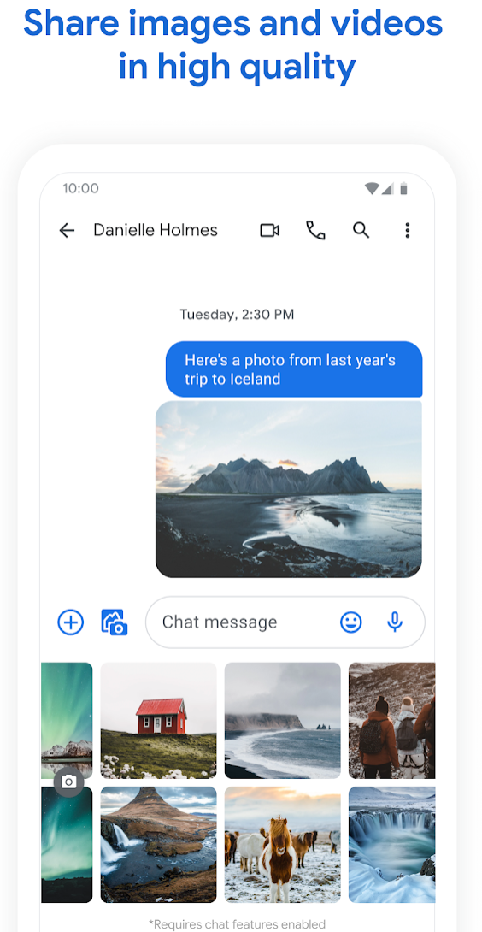
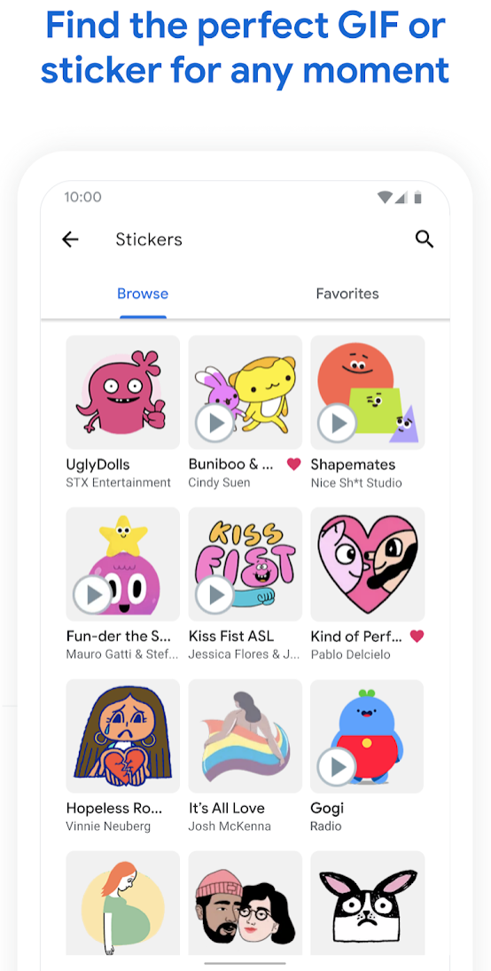
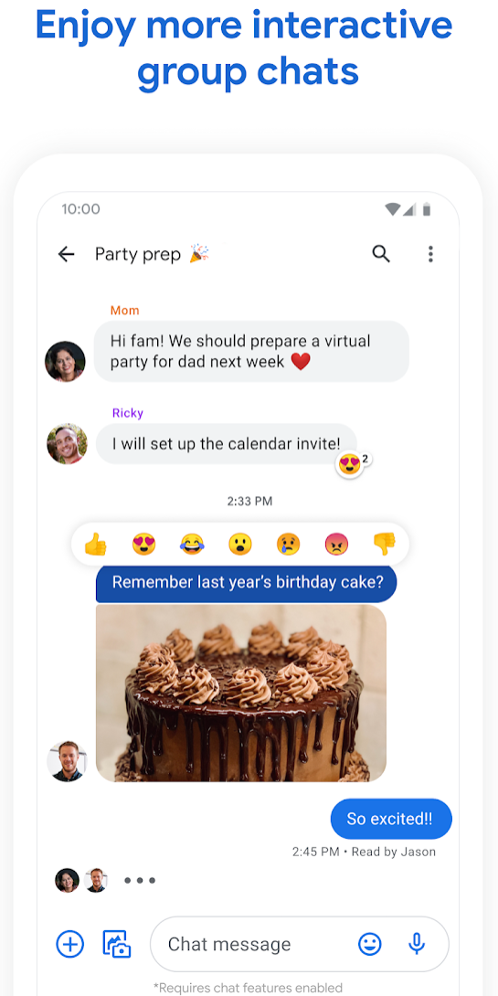
What is Google Messages?

Slide 8
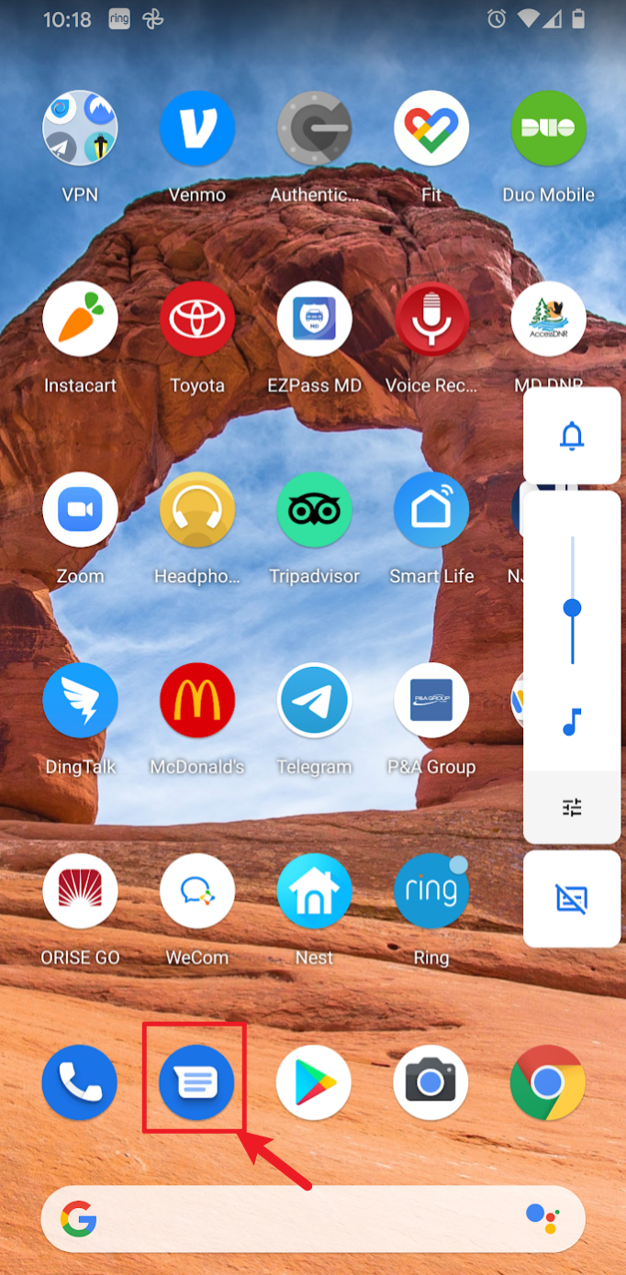
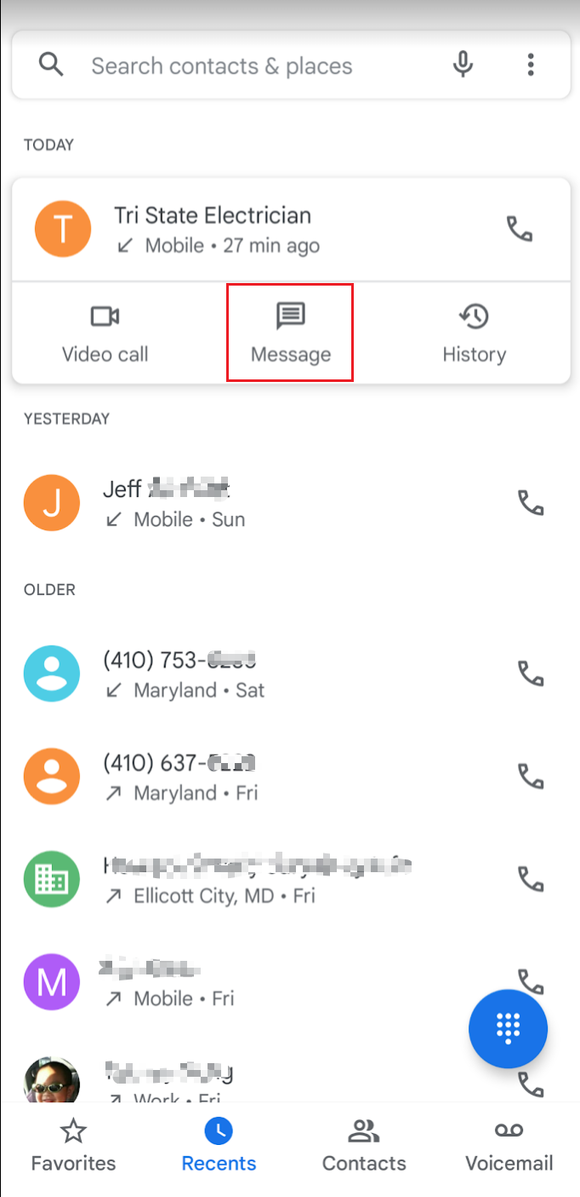
How to invoke Google Messages
Option 1
Option 2

Slide 9
Google Messages vs. AOSP messaging function of telephony service
Feature | Google Messages | AOSP Messaging
Rich Communication Services (RCS) Support | Yes | No
SMS/MMS Support | Yes | Yes
Web Interface | Yes | No
Smart Features | Yes (spam protection, suggestions) | No
End-to-End Encryption | Yes (for RCS) | No
Customization | Themes, chat bubbles | Minimal
Integration | Google Services | None
Resource Usage | Higher | Lower
Availability | Pre-installed or Play Store | Stock Android or custom ROMs
RCS: read receipts, typing indicators, high-quality media sharing, and group chats over Wi-Fi or mobile data

Slide 10
Where does evidence come from?
Generated by Android OS
Messages app description (static information, we focus)
Version of app, when was the app installed/updated
System logs (dynamic information)
App activities logs (covers in different classes)
Generated by Google Messages functionalities
Text
Chat
Group texts
Share pictures, videos, audio messages

Slide 11
1. How to find Messages app description
Locate packages.xml file
Stores metadata of all the apps
Metadata is structured information that describes, explains, locates, or otherwise makes it easier to retrieve, use, or manage an information resource.
Contains metadata of Google Messages
Version of app, when was the app installed/updated
Exam metadata

Slide 12
A: Locate the packages.xml file
grep: a command-line tool that allows you to find a string in a file
-i: Ignores, case for matching
-n: Display the matched lines and their line numbers
Notes:
Cmd: cat 'Pixel 3/data/system/packages.xml' | grep –in 'package name="com.google.android.apps.messaging“’
https://www.geeksforgeeks.org/grep-command-in-unixlinux/

Slide 13
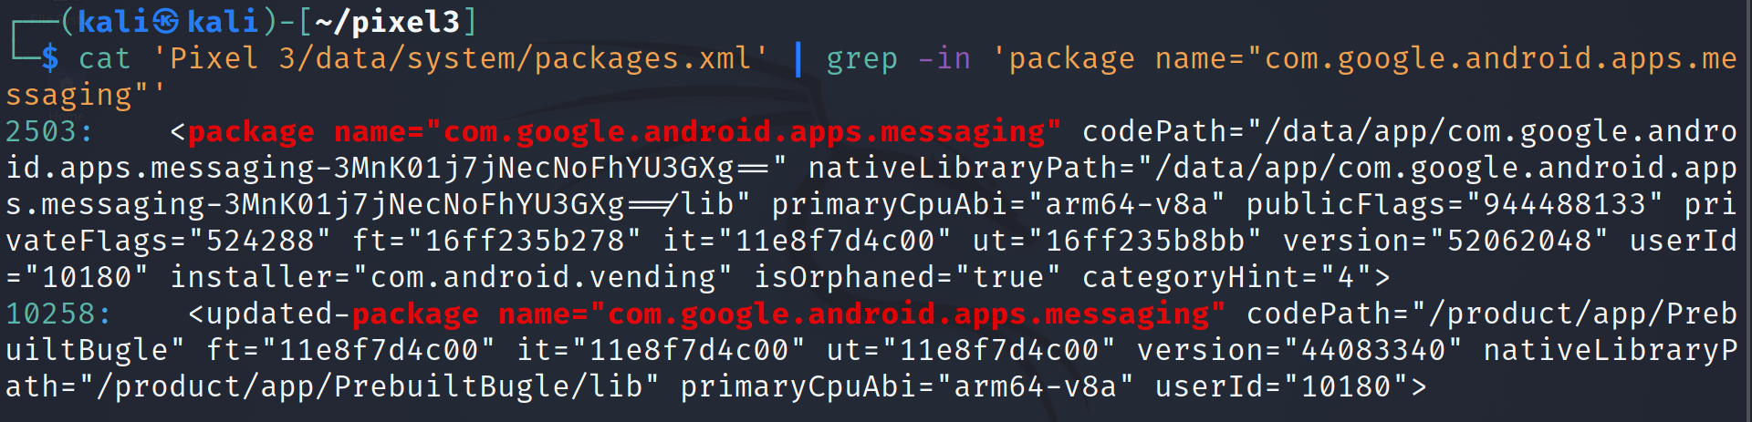
B: Exam metadata
Type​​ | Hex​​ | Integer​​ | Epoch​​
ft​​ (First-time installation) | 16ff235b278​ | 1580316603000​ | Wednesday, January 29, 2020 4:50:03 PM​
it​​ (init download) | 11e8f7d4c00​​ | 1230768000000​​ | Thursday, January 1, 2009 12:00:00 AM​​
ut​​ (last update​​​) | 16ff235b8bb​ | 1580316604603​ | Wednesday, January 29, 2020 4:50:04.603 PM​

Slide 14
Metadata attributes of packages.xml
​​​ | Attribute Name​​​ | Description​​​
1​​​ | name​​​ | package name​​​
2​​​ | codePath​​​ | APK file installation location (/system/app/ or /data/app/)​​​
3​​​ | nativeLibraryPath​​​ | native library (*.so file) default path is /data/data/<package name>/lib/​​​
4​​​ | flag​​​ | Store ApplicationInfo Flags [http://developer.android.com/reference/android/content/pm/ApplicationInfo.html]​​​
5​​​ | ft​​​ | timestamp in hex format of first time installation (milliseconds Unix epoch time)​​​
6​​​ | it​​​ | timestamp in hex format of what? (online notes are conflict with ft)​​​
7​​​ | ut​​​ | timestamp in hex format of last update​​​
8​​​ | version​​​ | Version Code from AndroidManifest.xml file [http://developer.android.com/guide/topics/manifest/manifest-element.html#vcode]​​​
9​​​ | sharedUserId​​​ | The name of Linux user ID that will be shared with other applications, It is same parameter which we define in AndroidManifest.xml [http://developer.android.com/guide/topics/manifest/manifest-element.html#uid]​​​
10​​​ | userId​​​ | The name of a Linux user ID (important to find the owner of apps)​​​

Slide 15




2. How to find evidence generated by Messages functionalities
A messaging scenario description using Google Messages
Forensic questions related to messaging
Approach to answer each question

Slide 16
A messaging scenario
The phone was received a message on Jan 29, 2020 at 06:20:45 pm
What is message?
Message is a verbal, written, or recorded communication sent to or left for a recipient who cannot be contacted directly.
Messages get stored in database as data is organized and easily readable
Message evidence includes
Who (Sender, Receiver)
What (Content of the message, e.g., text, pictures, audio, video)
When (Timestamps)

Slide 17
Forensic questions related to messaging
What is the content of the message the phone received on Jan 29, 2020 at 06:20:45 pm?
When was message sent by the other person?
Who sent the message?
Has the message been read?

Slide 18
a. What is the content of the message the phone received on Jan 29, 2020 at 06:20:45 pm?
Step 1: Find the database where message evidence is stored
Step 2: Find the table containing the message content
Step 3: Find the column containing the message content
Step 4: Find the information in a cell

Slide 19
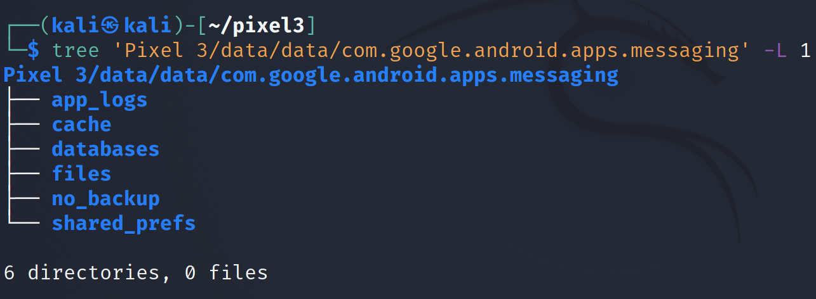
Step 1: Find database where message evidence is stored
Show Google Messaging package structure
-L: Level
Notes:
Cmd: tree 'Pixel 3/data/data/com.google.android.apps.messaging' -L 1

Slide 20
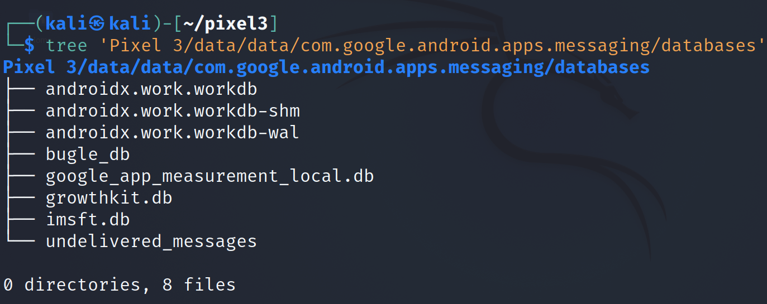
Show Google Messaging database
Notes:
Cmd: tree 'Pixel 3/data/data/com.google.android.apps.messaging/databases'

Slide 21
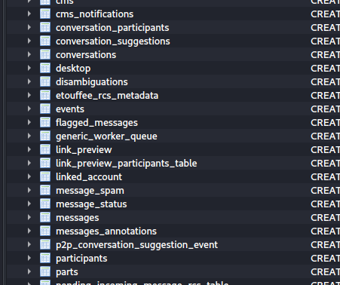
Step 2: Find the table contains the message content with timestamps
Open the message database (bugle_db)
Table contains a set of messages
Table contains messages and metadata (e.g., timestamps)
Notes:
Cmd: sqlitebrowser 'Pixel 3/data/data/com.google.android.apps.messaging/databases/bugle_db'

Slide 22
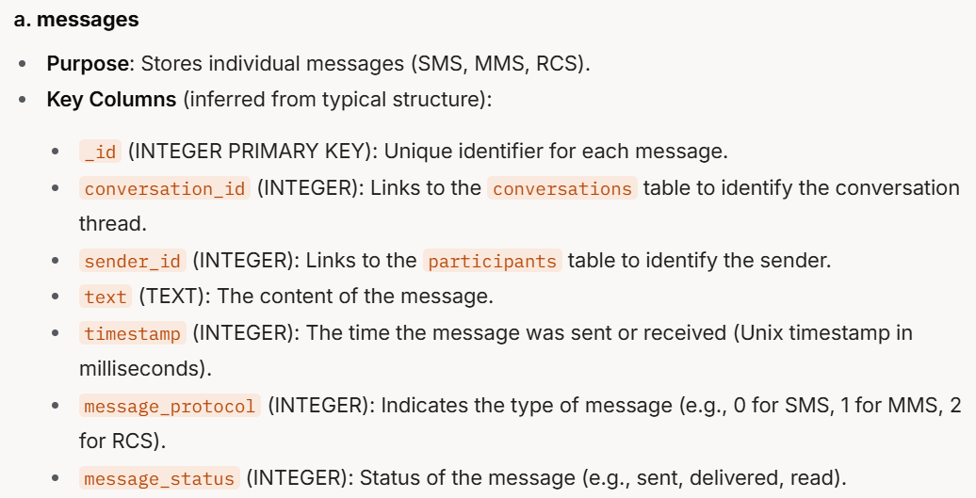
same as sms_message_uri column
Point to SMS database (mmssms.db).
Notes:
a. messages
Purpose: Stores individual messages (SMS, MMS, RCS).
Key Columns (inferred from typical structure):
_id (INTEGER PRIMARY KEY): Unique identifier for each message.
conversation_id (INTEGER): Links to the conversations table to identify the conversation thread.
sender_id (INTEGER): Links to the participants table to identify the sender.
text (TEXT): The content of the message.
timestamp (INTEGER): The time the message was sent or received (Unix timestamp in milliseconds).
message_protocol (INTEGER): Indicates the type of message (e.g., 0 for SMS, 1 for MMS, 2 for RCS).
message_status (INTEGER): Status of the message (e.g., sent, delivered, read).

Slide 23
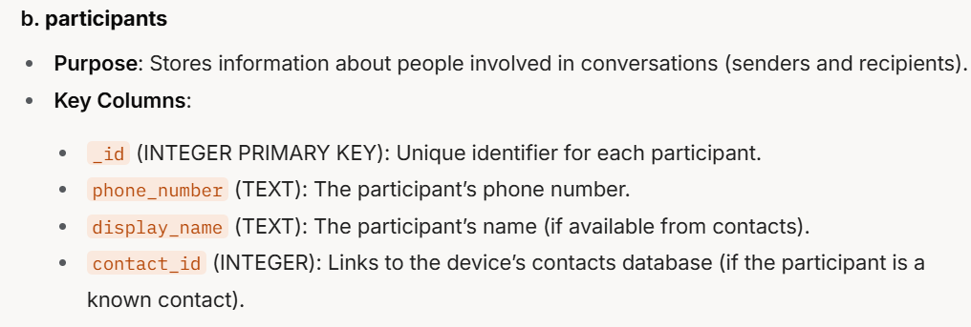
Notes:
b. participants
Purpose: Stores information about people involved in conversations (senders and recipients).
Key Columns:
_id (INTEGER PRIMARY KEY): Unique identifier for each participant.
phone_number (TEXT): The participant’s phone number.
display_name (TEXT): The participant’s name (if available from contacts).
contact_id (INTEGER): Links to the device’s contacts database (if the participant is a known contact).

Slide 24
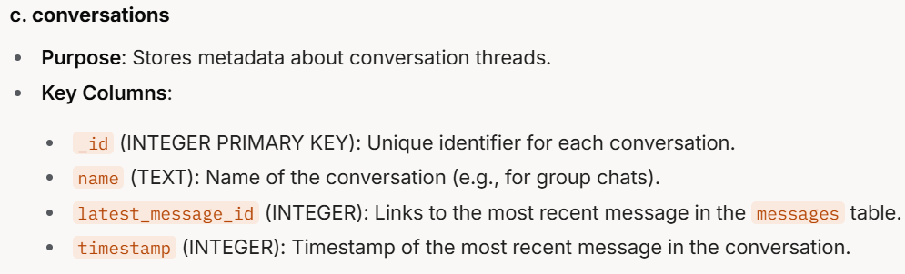
Notes:
c. conversations
Purpose: Stores metadata about conversation threads.
Key Columns:
_id (INTEGER PRIMARY KEY): Unique identifier for each conversation.
name (TEXT): Name of the conversation (e.g., for group chats).
latest_message_id (INTEGER): Links to the most recent message in the messages table.
timestamp (INTEGER): Timestamp of the most recent message in the conversation.

Slide 25
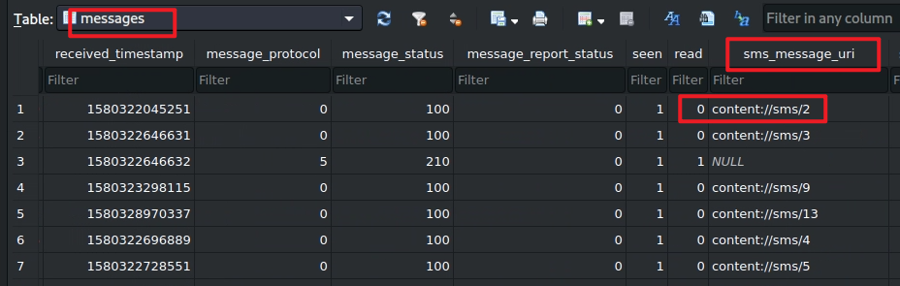
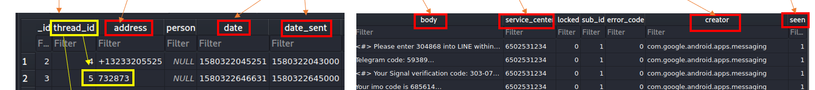

Step 3.1: Find the column contains the message
sms_message_uri column
Point to SMS database (mmssms.db).
Find message information

Slide 26
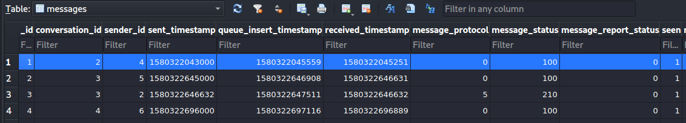
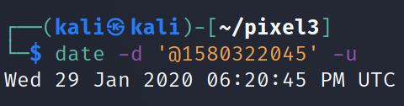
Step 3.2: Find the column contains the message received timestamp
Open the message table
The timestamp of Message received

Slide 27
Step 3.3 : messages are grouped in conversation
Find conversation id
conversation_id=2

Slide 28
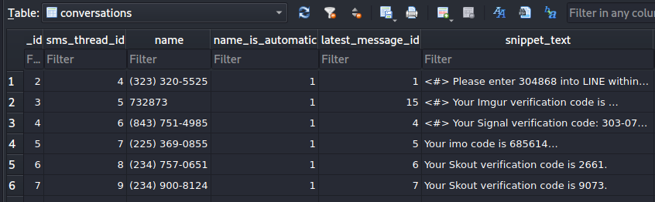
name of the conversation
Solution: message content sent on Jan 29, 2020 at 06:20:43 pm
Find _id=2 in conversations table

Slide 29
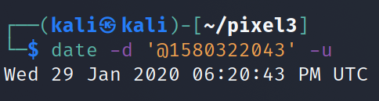
b. When was message sent by the other person?
In the same table
The timestamp of Message sent

Slide 30
c. Who sent the message?
link to participate table

Slide 31
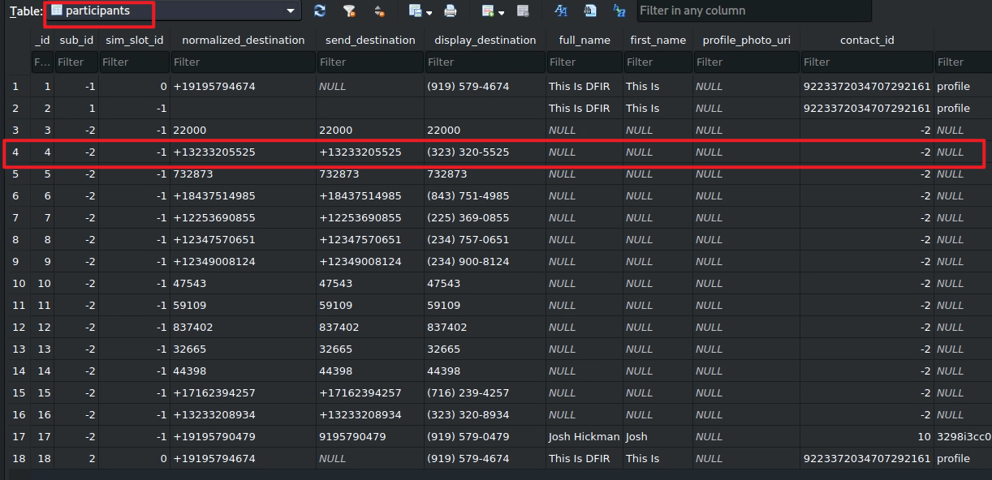
international format
user-friendly format
-2: no contact match

Slide 32
d. Has the message been read?
Seen: read flag
0: False, message has not been seen
1: True means its has been seen
Open the message table

Slide 33
To summarize
Understand the application
Locate the packages.xml for the metadata of the application
Look at the application directories
Go to the "databases" directory
Open bugle_db
Explore these tables: messages, conversations, participant
Fetch the information needed from these tables

